Slide 1
Timing the market with Congress
NYC Data Science Academy – R Project
February 24th, 2023
Brian Ralston
Notes:
­­­­Thank you all for your time, and welcome to my presentation: ”Timing the market with Congress”
For my presentation, I chose to analyze a collection of financial disclosure reports from Congress representatives over the past 9 years.

Slide 2
Notes:
What are these reports that they need to file?
Periodic Transaction Reports (PTRs) are a type of disclosure required by the STOCK Act of 2012. The STOCK Act requires certain government officials and employees, including members of Congress and their staff, to publicly disclose their financial transactions within 45 days of the transaction. These reports are then made publicly available through the Clerk's website.
The purpose of PTRs is to increase transparency and reduce the potential for conflicts of interest in government. By requiring timely disclosure of financial transactions, the public can see if an elected official or government employee has made trades that could be influenced by their position or access to non-public information.

Slide 3
Notes:
Just like many government programs, they make it publicly available, but not easy to access.
The clerk’s office doesn’t offer the information aggregated in a csv, or have an api. Instead, they publish individual .pdfs of each and every submission
Despite the challenges, there are a few online communities that have taken these forms and created a database of the information to for easier public review. For my project, I depended on the website https://housestockwatcher.com/api for their api which is maintained by Timothy Carambat
They have a community of people who review the .pdf’s daily and manually transcribe the data into this database.

Slide 4
Notes:
Over the past few 3-4 years, there has been increased dialogue around insider trading in congress. I have been loosely following the news on this, but it started to interest me once I realized that investors were actually using these reports to weigh there decisions in what stocks to buy and sell.
Influencers online started touting these documents as cheat sheets for some quick money. Twitter accounts like Pelosi tracker started popping up (which currently has 250k follower) sending out alerts when Pelosi would file one of these reports.
This type of news gained so much traction that two ETF’s just started trading on the market the other day on February 8th 2023
The ETFs NANC and KRUZ are a joint effort between investment firm, Subversive Capital, and equity data platform, Unusual Whales. The ETFs buy and sell securities based on an analysis of the disclosures mentioned above by Unusual Whales and are separated into Democratic (NANC) and republican (KRUZ). Both funds are actively managed and carry a hefty annual fee of 0.75%

Slide 5
Notes:
There are A LOT of these transactions on file; roughly 22k so far.
And it’s hard to trust social media influencers sometimes. Which representatives could I copy for their trading “strategies”. Which party performs better? democrats or republicans? Which ETF Should I buy NANC or KRUZ?
Let’s start bigger picture and look at aggregates. After we look at some of that info we’ll dive in deeper to some individuals that made some particularly well timed trades.

Slide 6
Notes:
Here is the information That I have access to for every on each those trades in my database.
"ticker"
"disclosure_year"
"disclosure_date"
"transaction_date"
"lower_bound"
"upper_bound"
"asset_description"
"asset_type"
"type"
"owner"
"representative"
"branch"
"district"
"state"
"cap_gains_over_200_usd" "industry"
"sector"
"party"
"comment"
Appended Information:
The adjusted Close Price of the ticker on the date of that transaction
The price of that same stock 7/30/90/365 days later and the price todate
The price of a S&P 500 ETF on that same date with the same additions of 7/30/90/365 days later
Branch of the Government : Senate or House

Slide 7
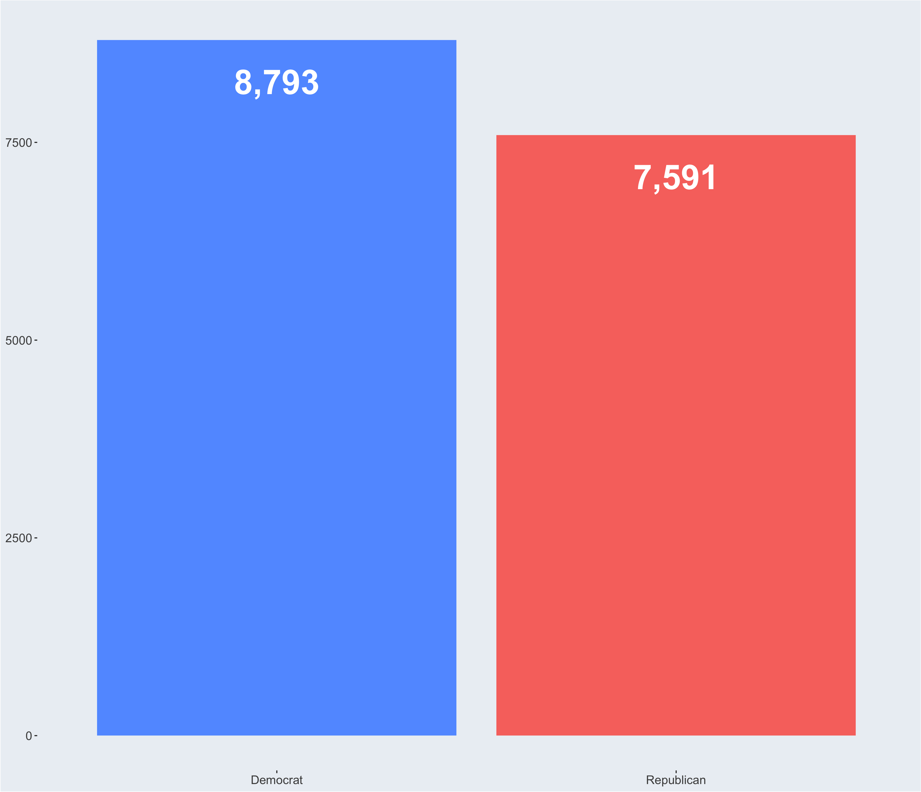

Slide 8
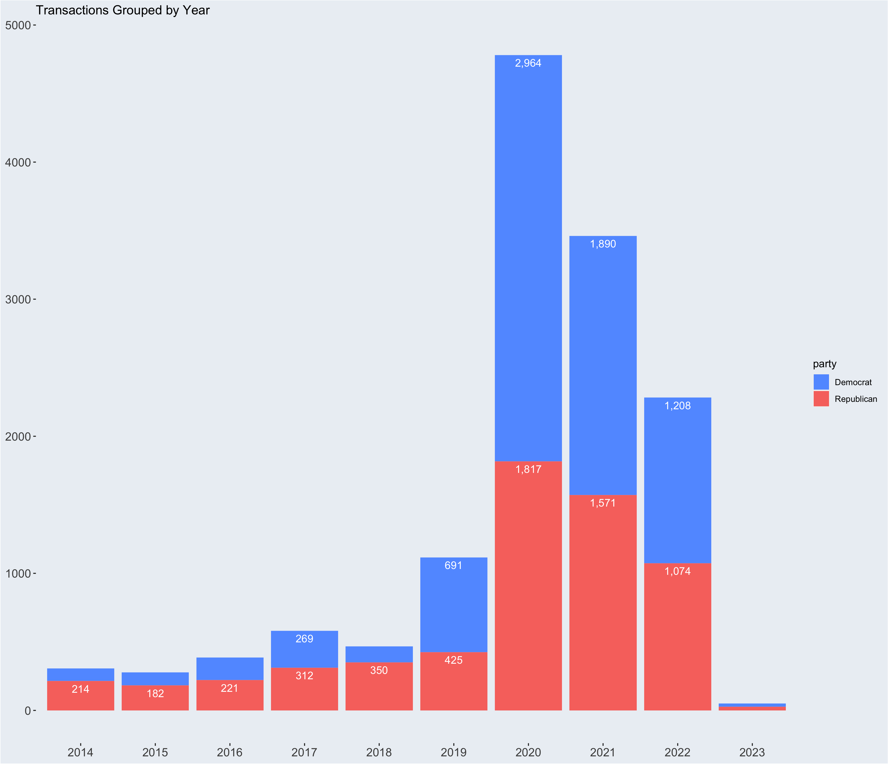
Notes:
Here are some quick summary stats about the dataset.
The observations took place from 2014-01-31 through 2023-02-06
After Cleaning the data There were 16,430 valid observations to analyze
8410 were buy
8020 were sell
13% of sell transactions were sold for a gain over $200
trade value range is from $1,000 through $50,000,000 with an average range of $22,517 - $80,306 and median of $1,000 - $15,000
Most active Traders (# transactions)

Slide 9
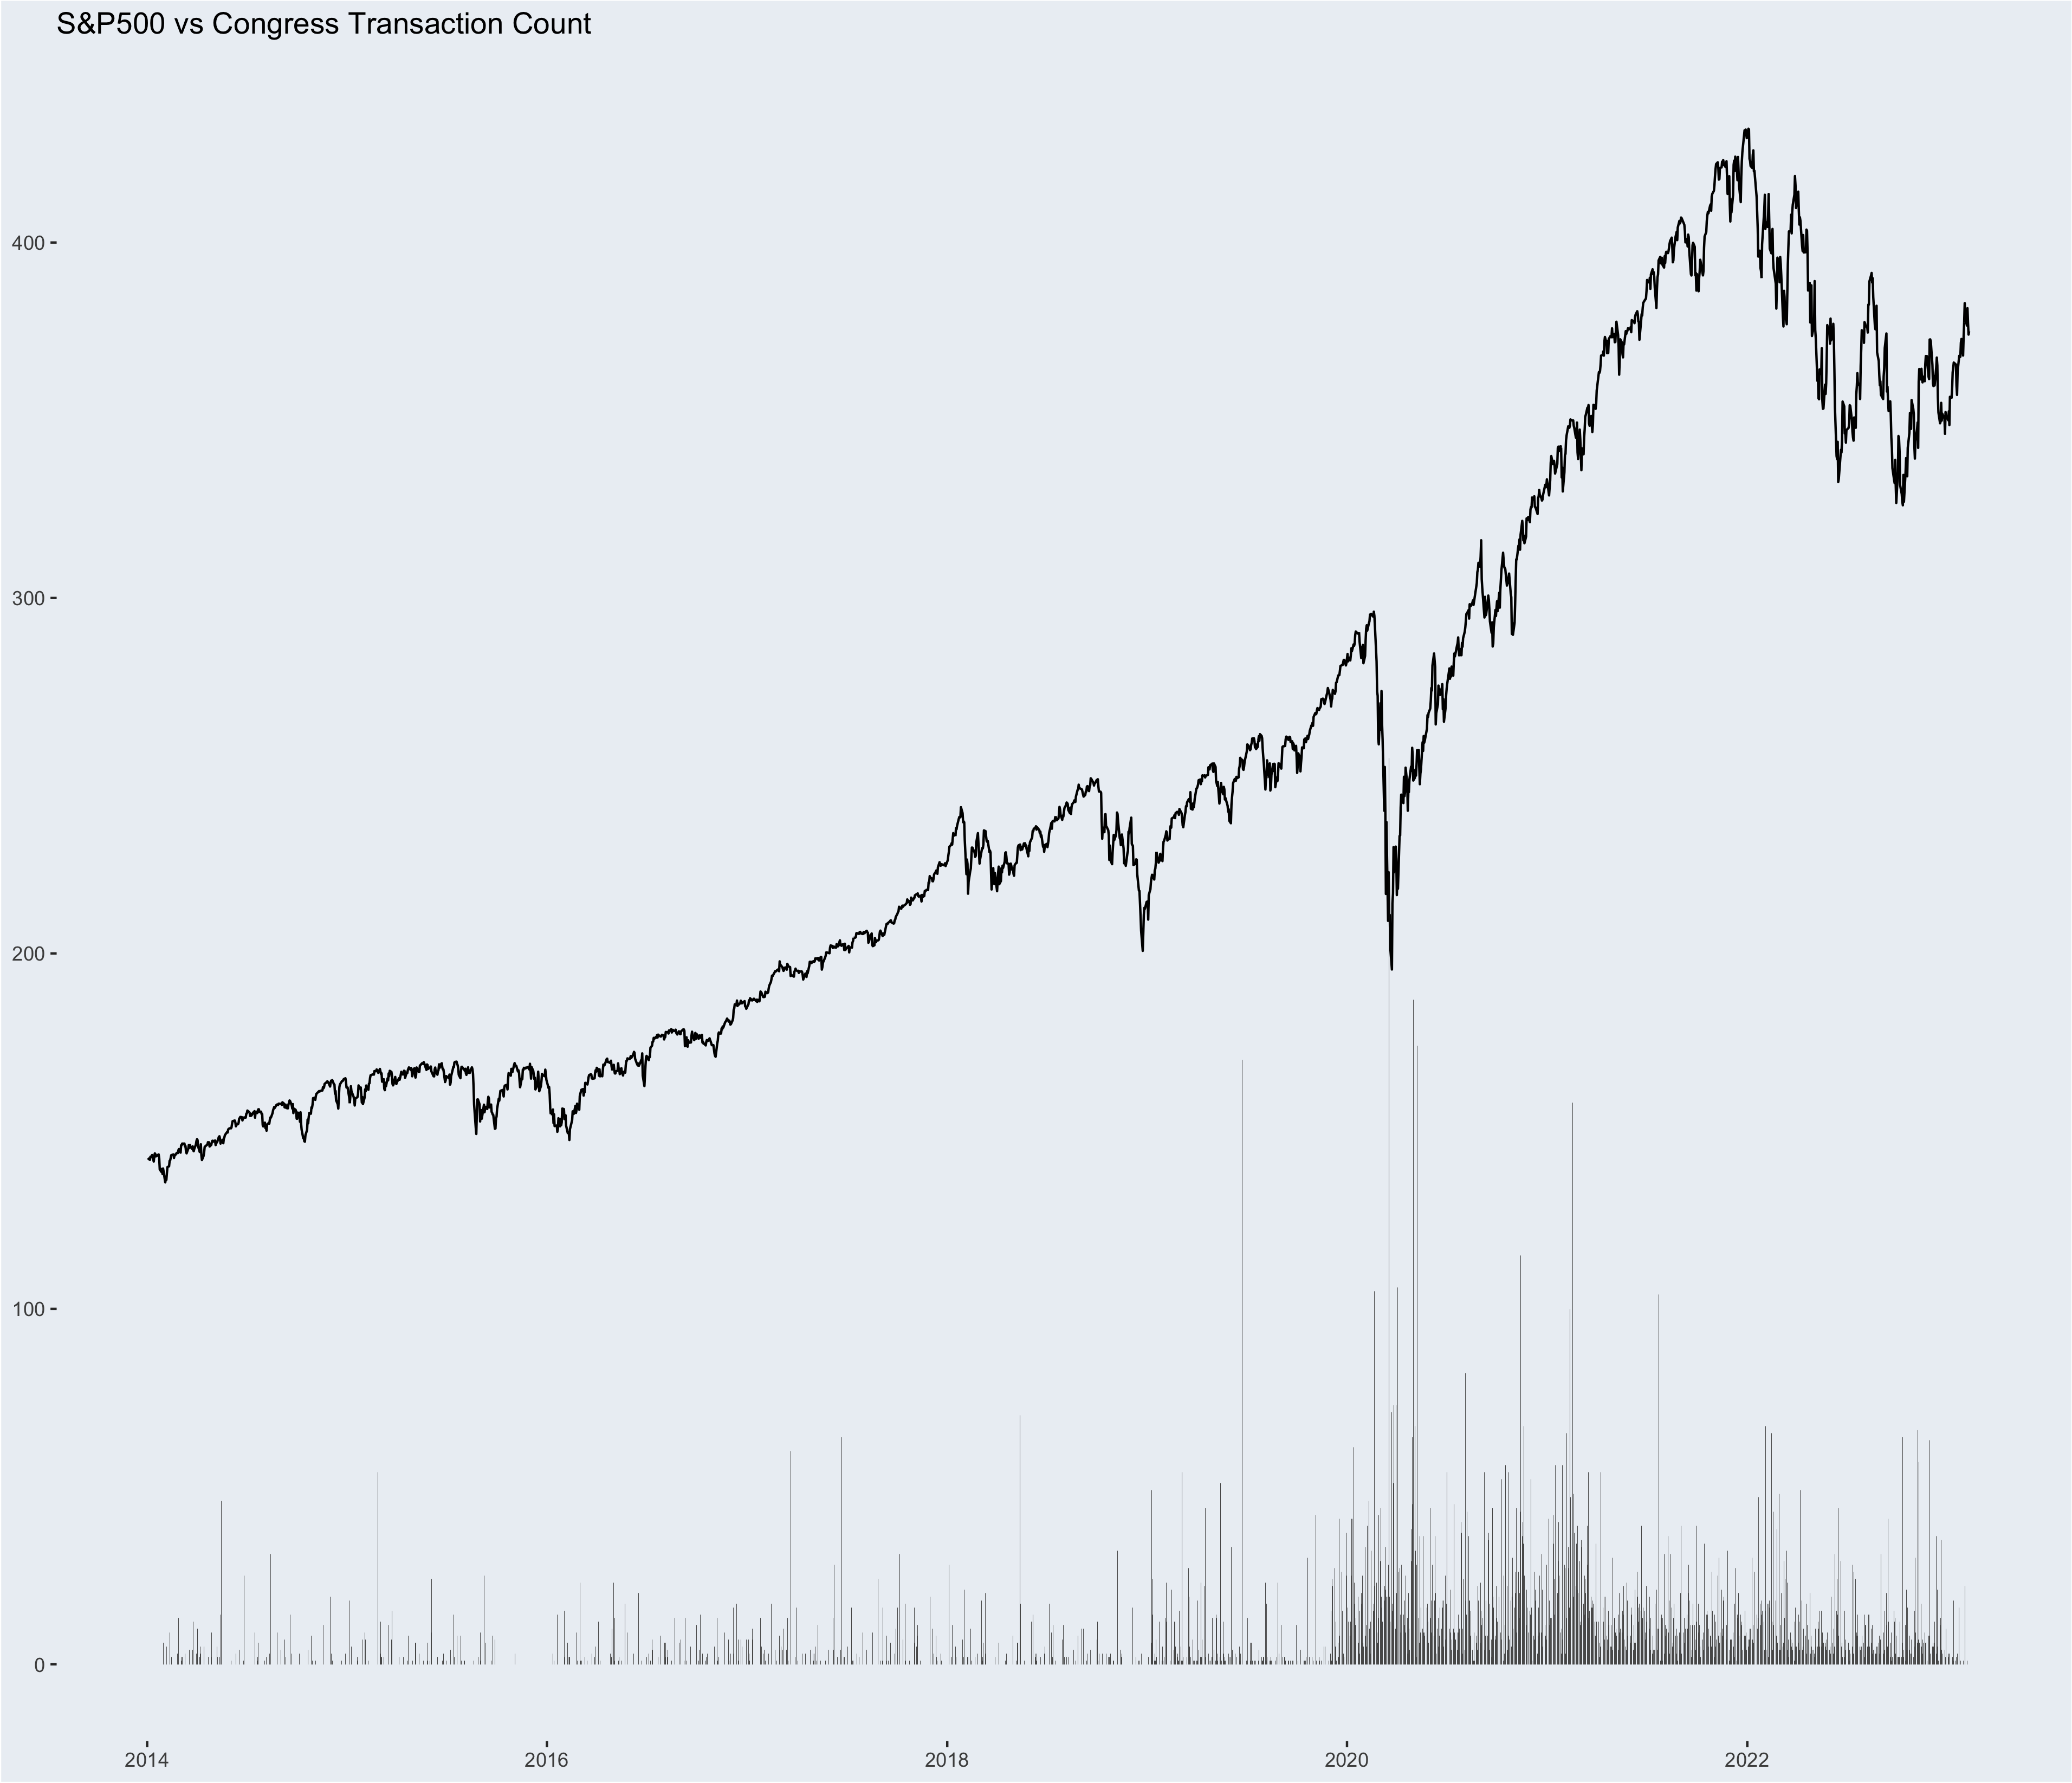
Notes:
Timing the Market

Slide 10
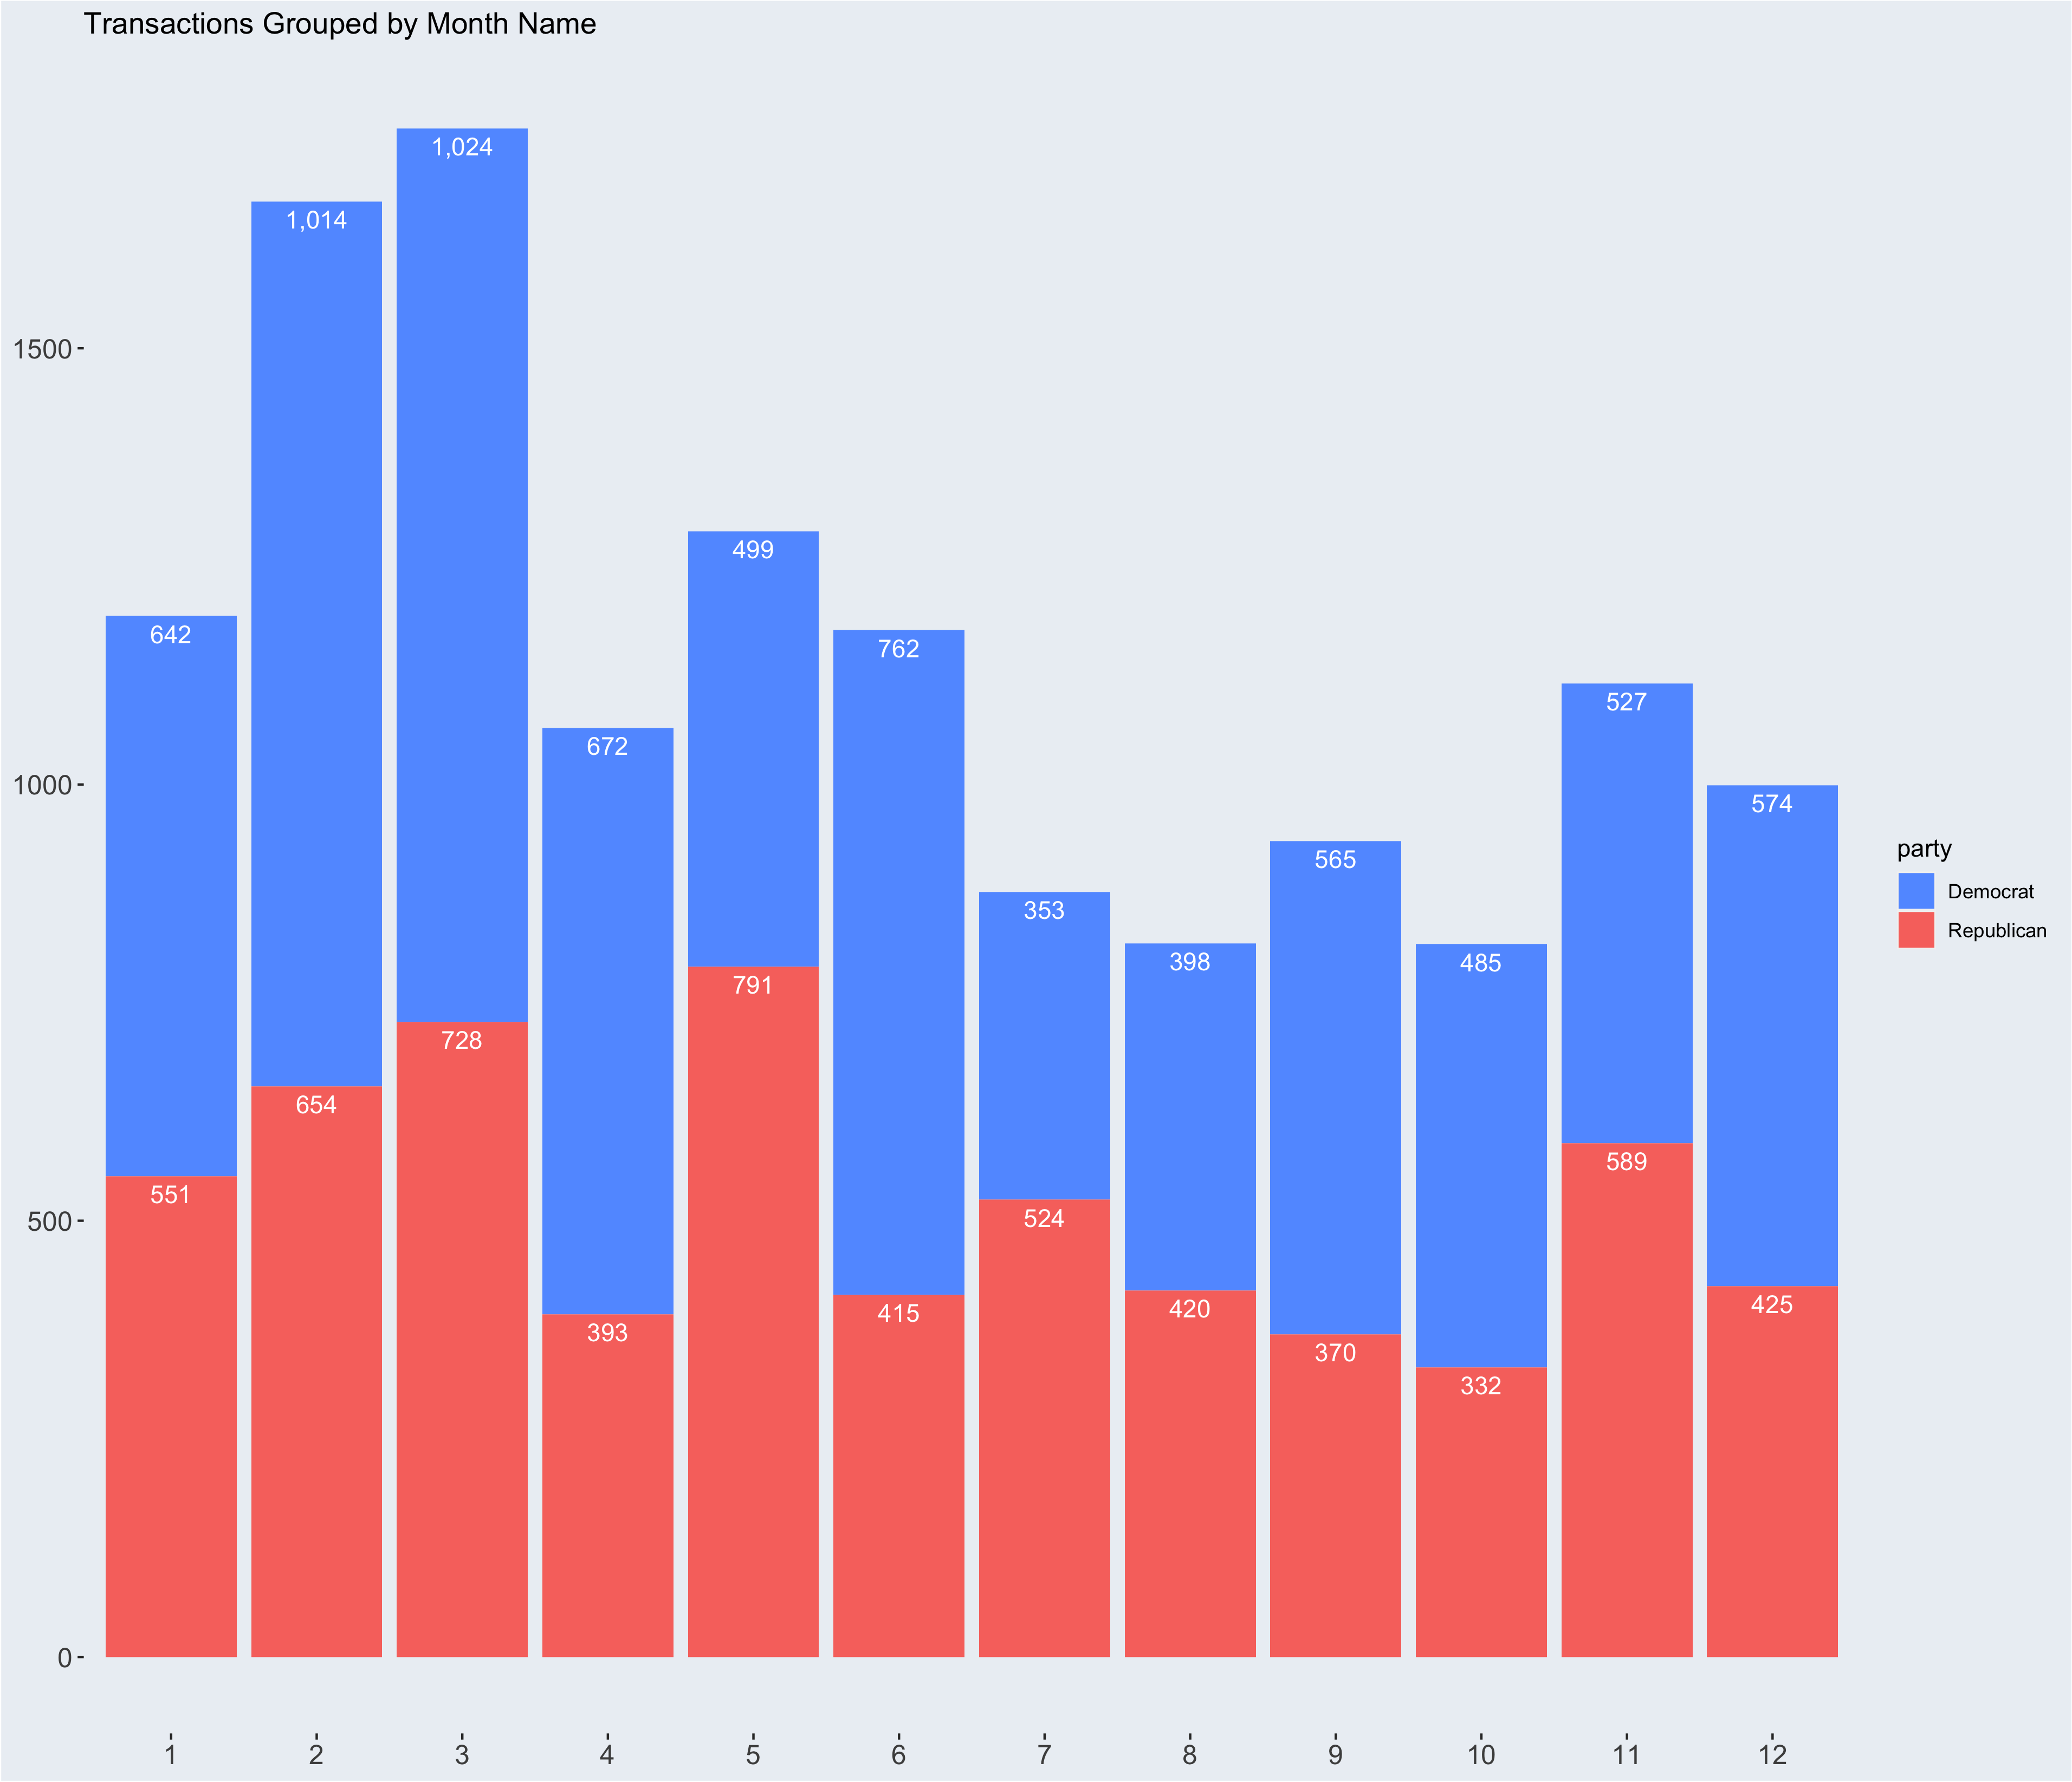

Slide 11
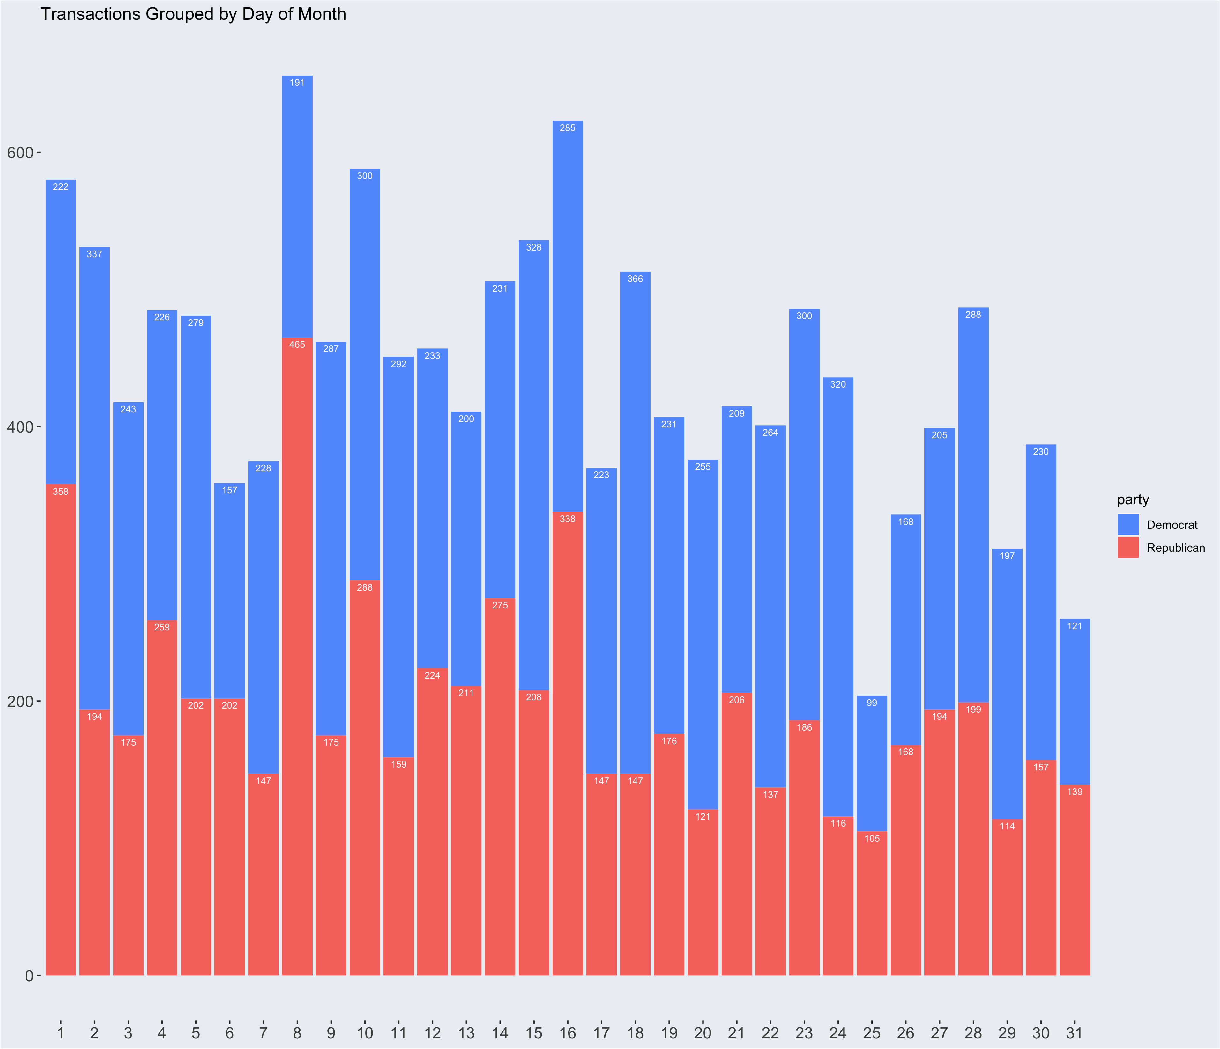

Slide 12
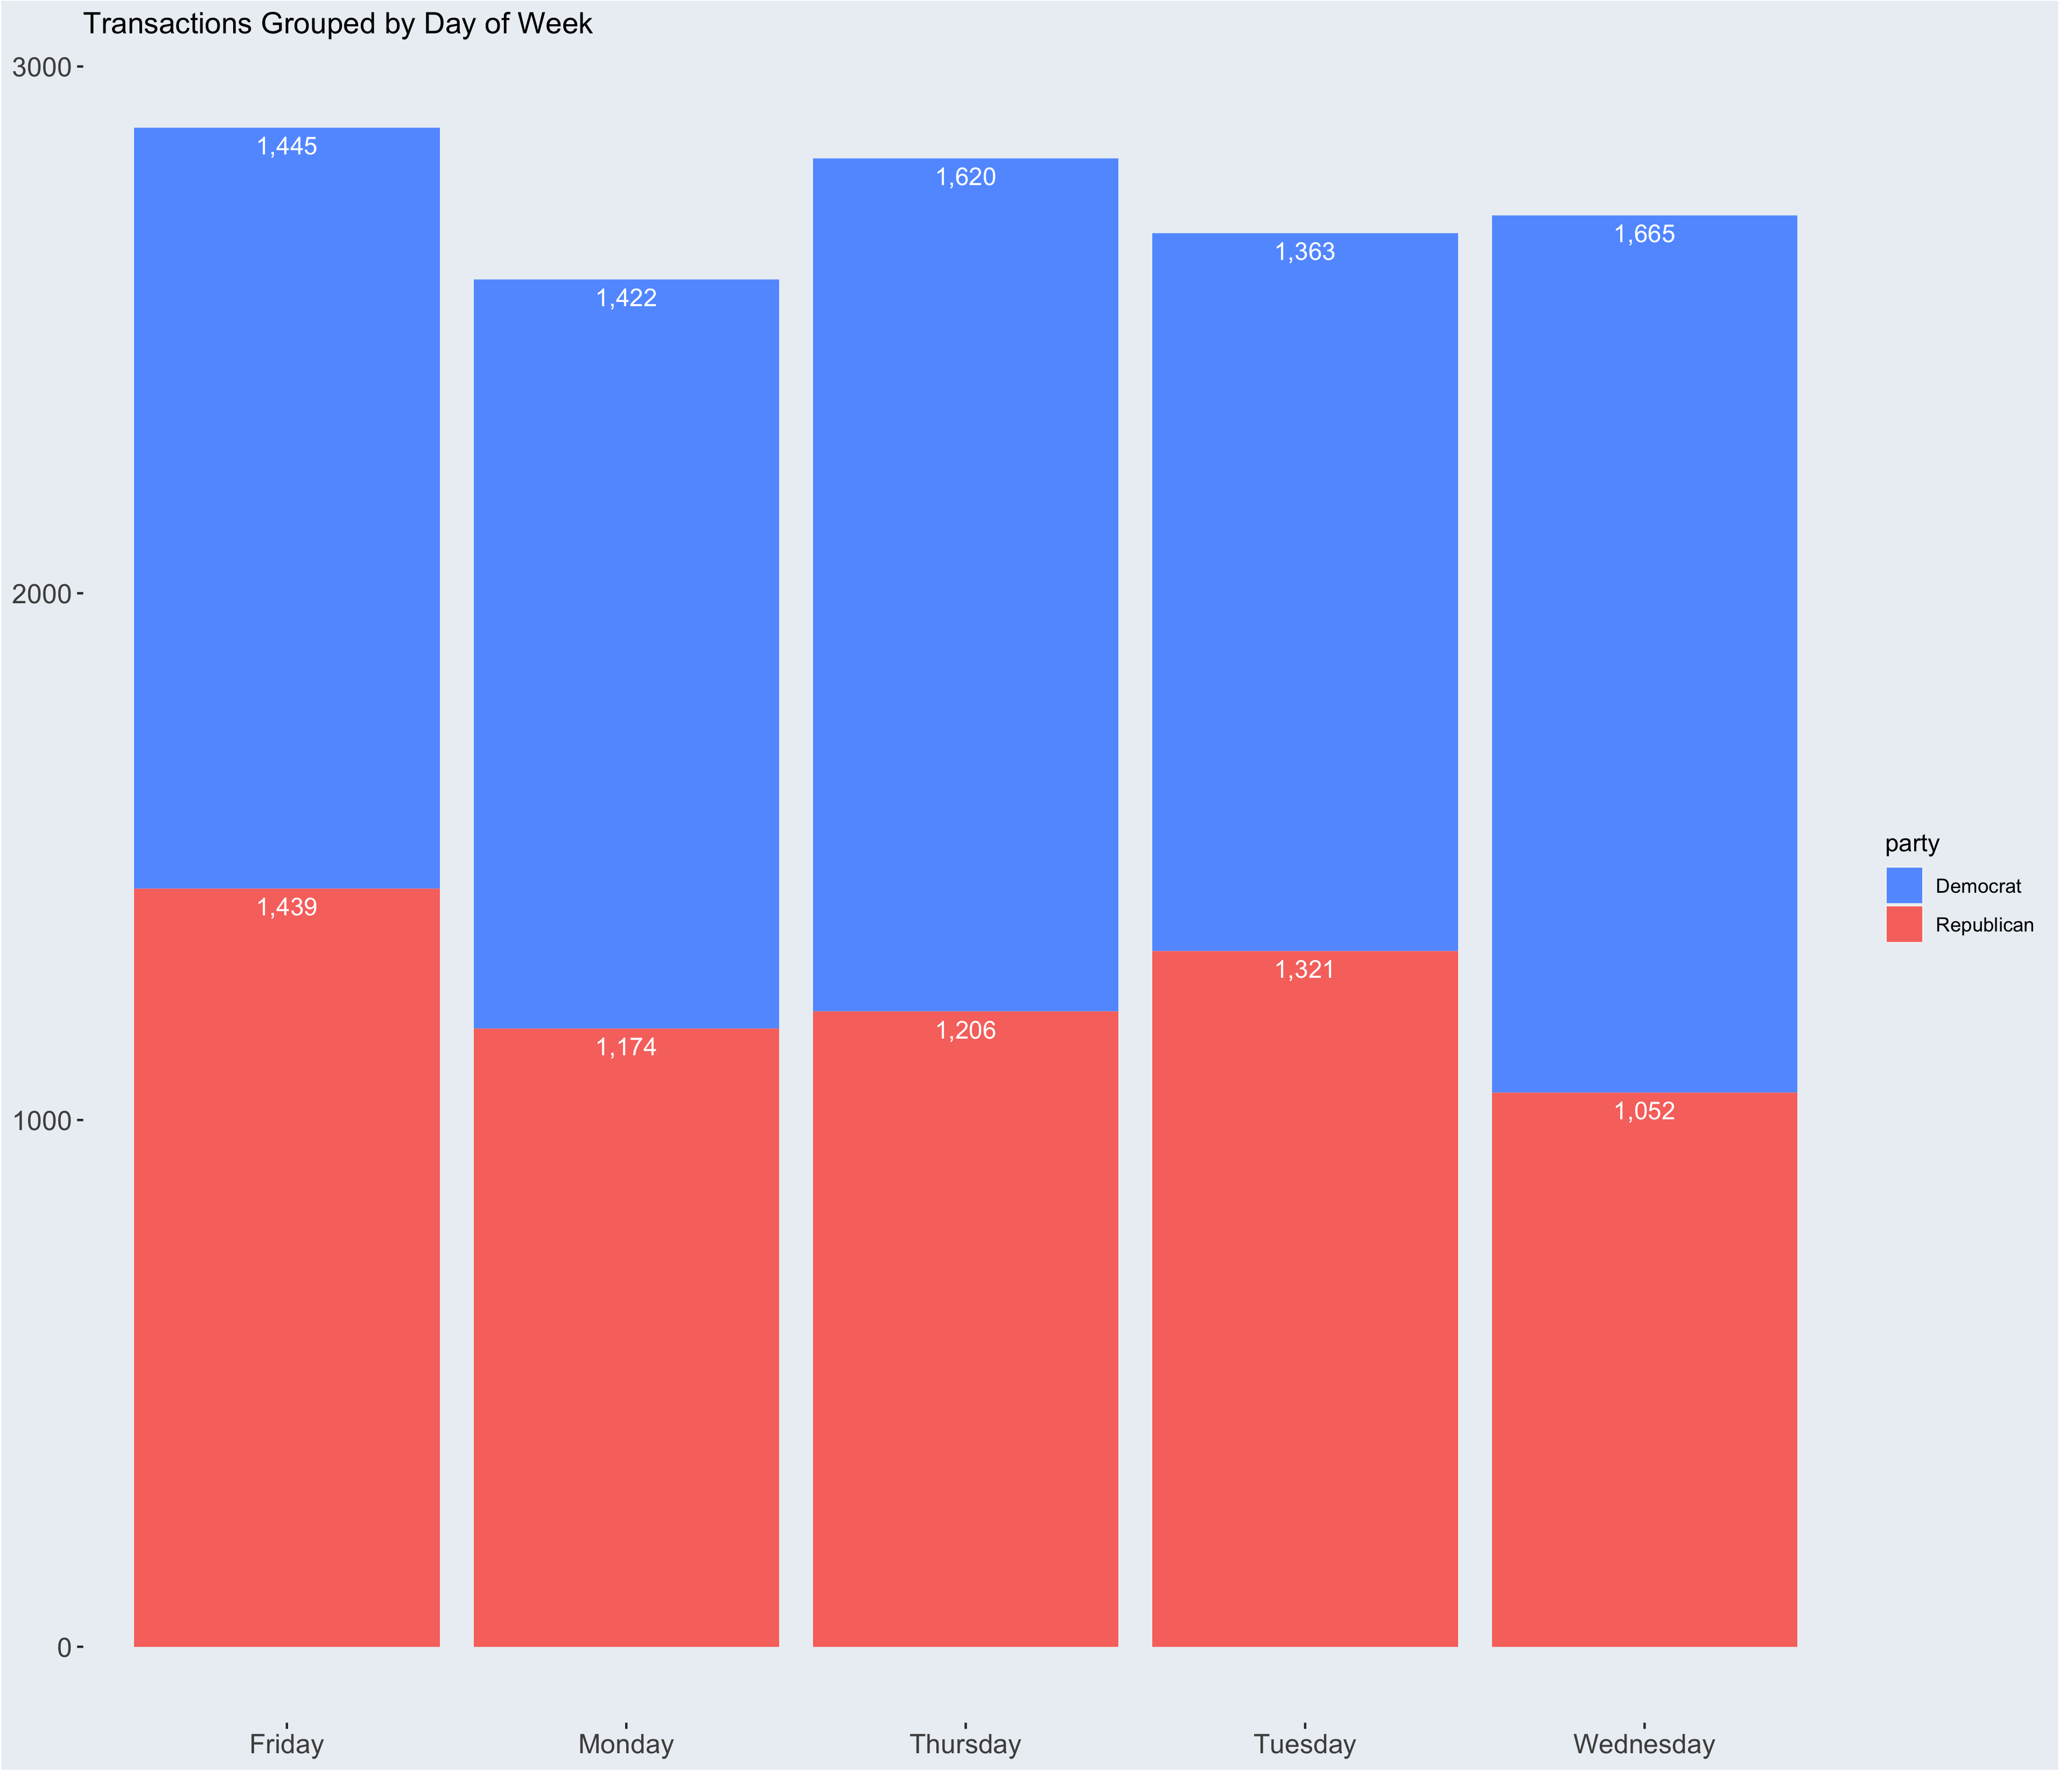

Slide 13
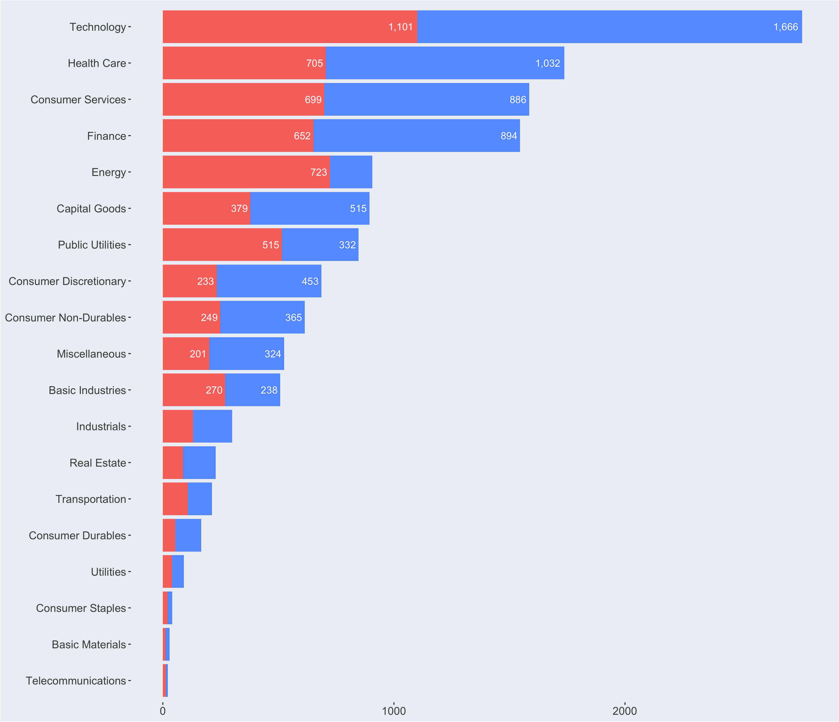

Slide 14
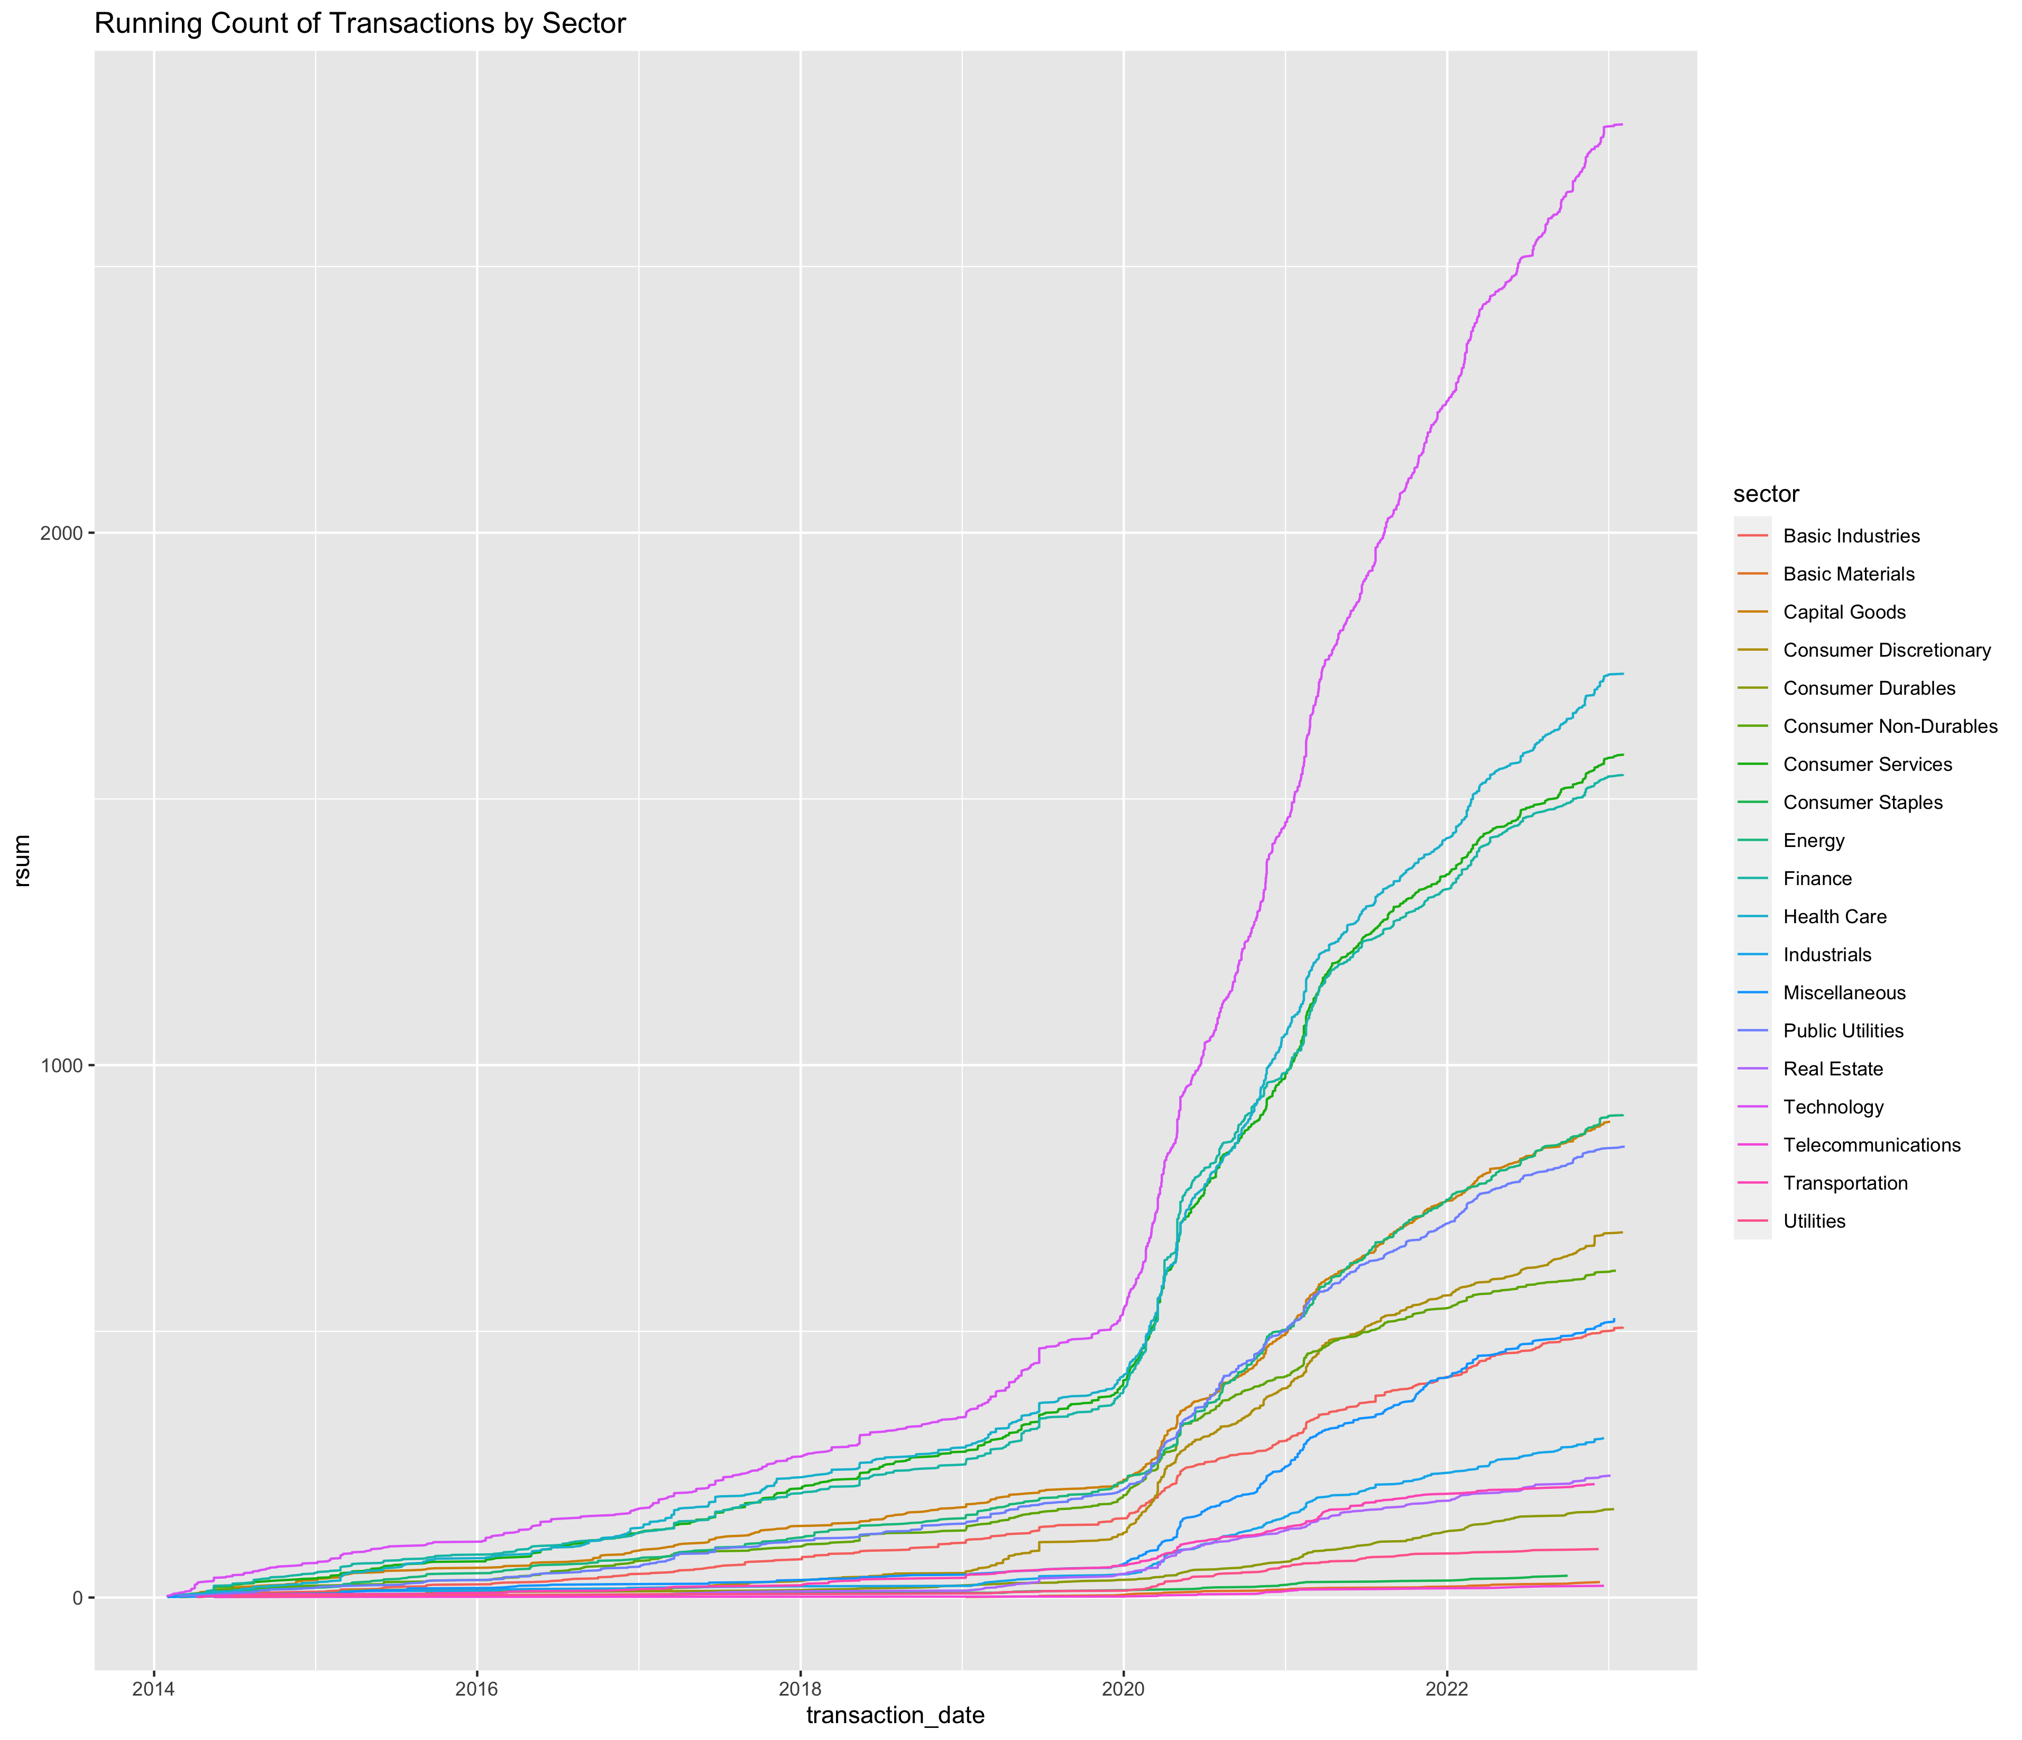

Slide 15
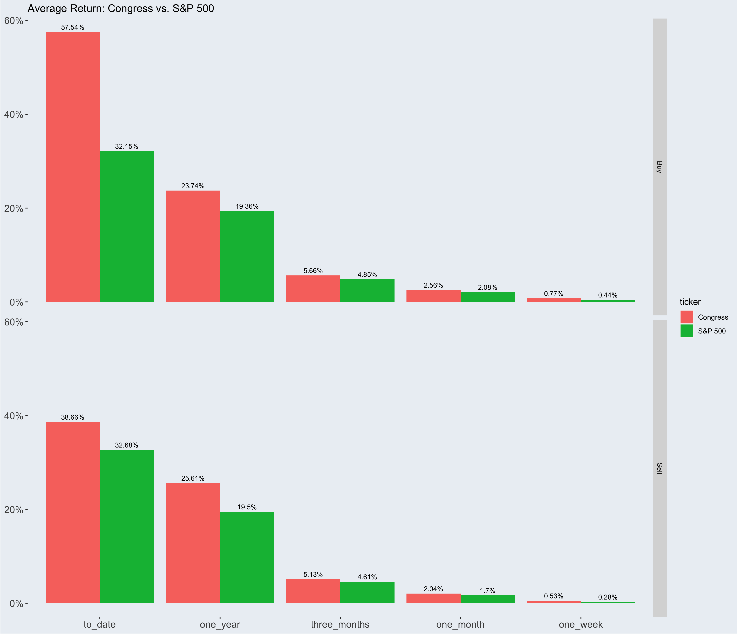
Notes:
Comparing the performance of the government as a whole to the performance of the S&P 500, ALll across the board, the GOV beat the S&P 500. One month by .48%, three month by .81% and one year by 4.38
­

Slide 16
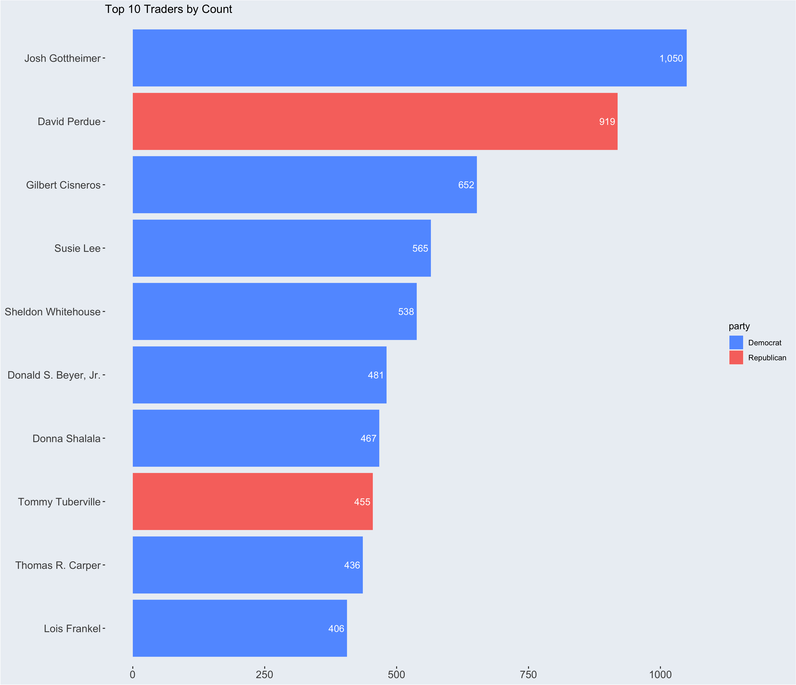
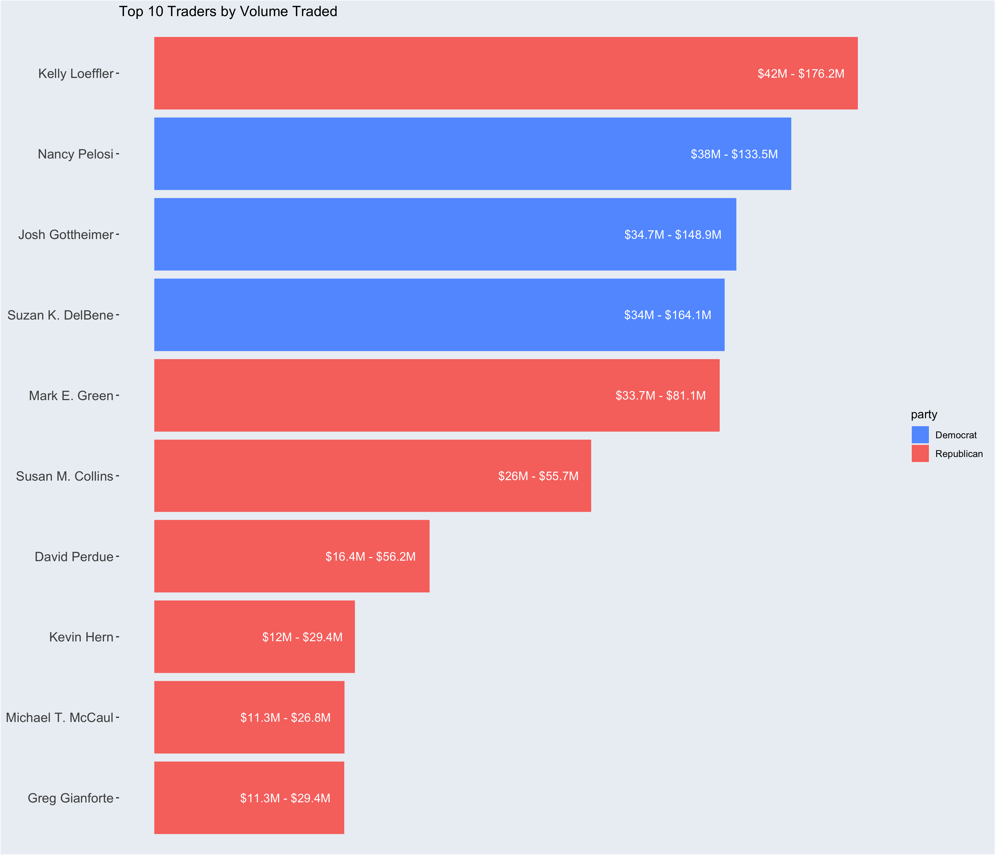

Slide 17
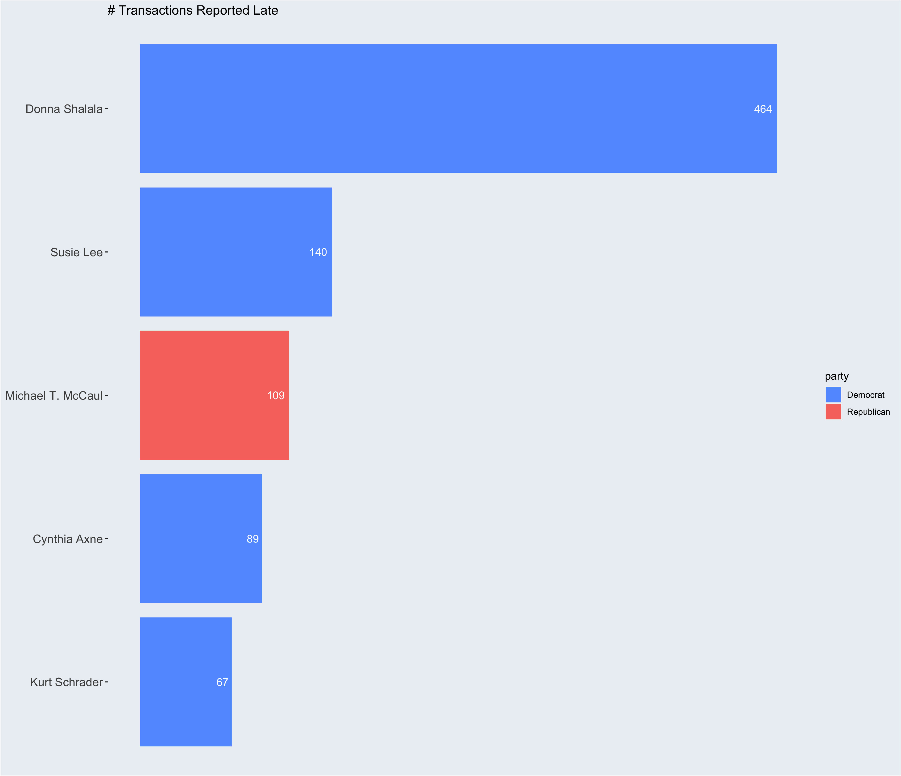
Notes:
Representatives are required to report transactions before 45 days after the transaction. However, the average delay was 57.25 days, the max delay was 1640 days and the min delay was 1 day. There were 1,883 transactions and 85 representatives that reported late. Of those reps, the top 5 egregiously do not follow that rule. Of all 1883 transactions, NO ONE left a comment in the form saying why it was late. Only 375 used the comment part of the form anyway

